Slide 1


Packet-level Micro-behavior Classification with Convolutional Neural Networks (CNNs)

Slide 2

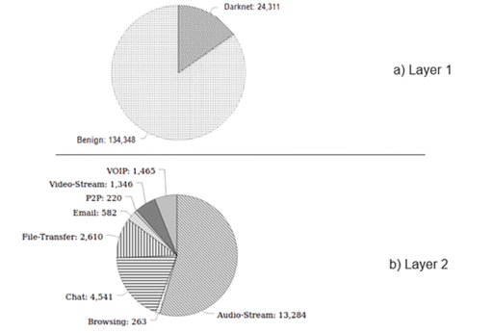

Introduction
Objectives
2
Motivation & background
1
This project aims to classify network packets into 4 categories of Tor, Non-Tor, VPN or Non-VPN to aide in the detection of these technologies to prevent malicious use.
Traditional traffic classification methods, relying on port numbers or Deep Packet Inspection (DPI), struggle to differentiate between encrypted traffic types, making them less effective against modern evasion techniques.
3
Dataset details
For this study, the CICDarknet2020 data was used. In CICDarknet2020 dataset, a two-layered approach is used to generate benign and darknet traffic at the first layer.
The dataset comprises of 24311 Darknet entries and 134348 Benign entries (total 158659 entries) split over different applications used

Slide 3



Methodology
Data preprocessing
Training & development
Performance metric
Testing

Slide 4

data preprocessing
Data cleaning
Scaling
Data cleaning is a crucial part of preparing data for a ML model training, it ensures that the data is consistent, not having missing values and contain only relevant information. Data cleaning consists of handling missing values, removing duplicate or irrelevant information and fix structural issues.
We need to convert the data into a format suitable for the machine learning models. This comprises of activities like feature selection, scaling and normalization, feature encoding, etc. Similarly, Continuous numerical features (e.g., packet size, time intervals) are normalized to ensure all values are on a similar scale.
training and Testing
. Out of the dataset, we require some data, to train the models, and some to test the accuracy of the models. A proper train-test split ensures the model generalizes well to unseen data.

Slide 5
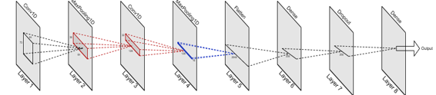
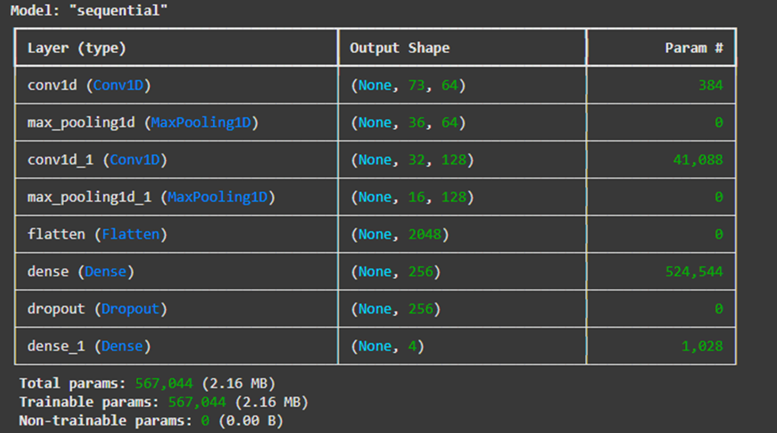
MODEL TRAINING & DEVELOPMENT
Architecture Design
Conv1D: Extracts spatial features from input metadata
MaxPooling1D: Down samples data to reduce computation
Flatten: Converts 3D output to 1D for dense layers
Dense: Performs final classification
Dropout: Prevents overfitting by randomly deactivating neurons during training
Clustering models group similar data points together, identifying patterns and insights.

Slide 6
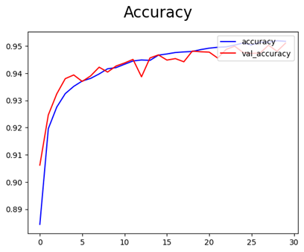
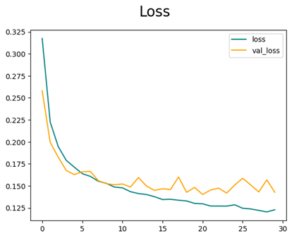
TRAINING AND PERFORMANCE METRICS
metrics
The model was trained for 30 epochs using a batch size of 64 to ensure efficiency.
accuracy
With continuous evaluation of accuracies and loss, the final epoch iteration gave an accuracy of 95.09%.
loss
With each iteration, the loss goes down, which is ideal for a ML Model

Slide 7
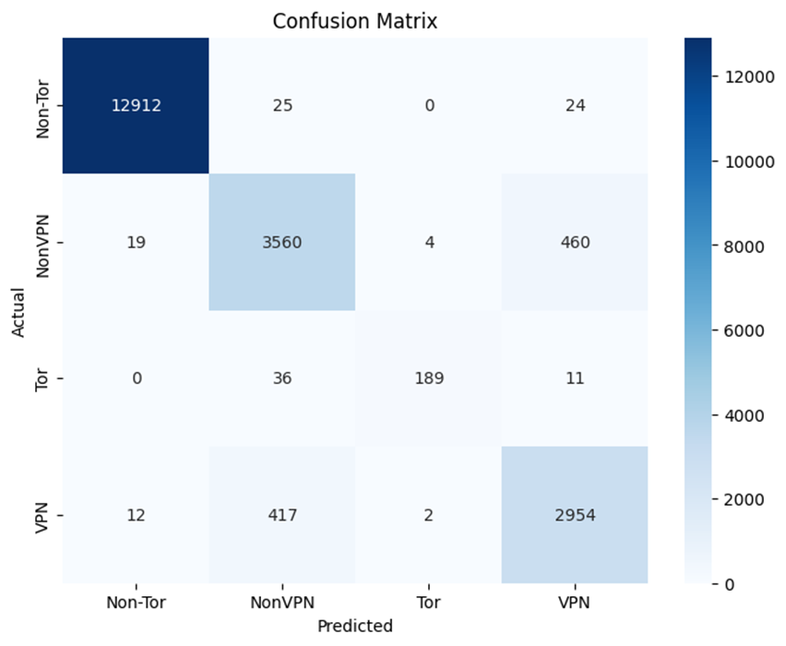
TESTING AND EVALUATION
The trained CNN model was tested and evaluated on 20% of the dataset (approx. 20,625 samples) giving an overall accuracy of 95.09%, along with a precision of 0.99 and a recall of 0.99 as well, indicating strong performance in classification of different network packets. The final classification report showed high precision and recall for most classes, with very strong results for Non-Tor class and respectable scores for VPN and Non-VPN classes. A confusion matrix was also generated to visualize the class-wise predictions and misclassifications of the model as follows:

Slide 8



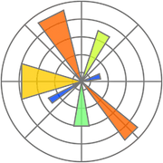

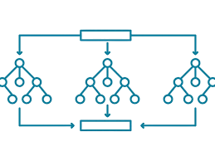
TOOLS & TECHNOLOGIES USED
Programming Language
Libraries & Frameworks
ML Techniques
Python language was chosen for the development of this CNN model due to its large selection of ML libraries and functionalities.
Pandas, NumPy – Data handling and numerical operations
Scikit-learn – Preprocessing, feature selection, and splitting dataset
TensorFlow / Keras – Building, training, and evaluating the CNN model
Matplotlib – For visualizing model performance (accuracy, precision, recall, etc.)
LabelEncoder & StandardScaler – For data encoding and normalization
Random Forest: A commonly-used machine learning algorithm that combines the output of multiple decision trees to reach a single result.
Convolutional Neural Network: A convolutional neural network (CNN) is a category of machine learning model.

Slide 9

Future improvements
Model Enhancement: Experiment with deeper CNN architectures or advanced models like Transformers and TCNs for potentially higher accuracy.
Multi-label Classification: Extend the model to simultaneously predict traffic type (Browsing, P2P, etc.) along with VPN/Tor classification.
Real-Time Detection: Integrate the trained model into a real-time traffic monitoring system for live packet analysis.
Explainability: Add explainable AI (XAI) techniques to understand why the model classifies certain traffic as Tor/VPN.
Cross-Dataset Validation: Test and fine-tune the model using other datasets to improve generalizability across different network environments.

Slide 10


thank you!
Siddharth nigam
229303311

